Slide 1
Curful’s webpage
Welcome !

Slide 2
Reasons why I’m studying programming..
Freelancing
Creativity involved
High income
Love to code

Slide 3
You should learn at least one language.

Slide 4
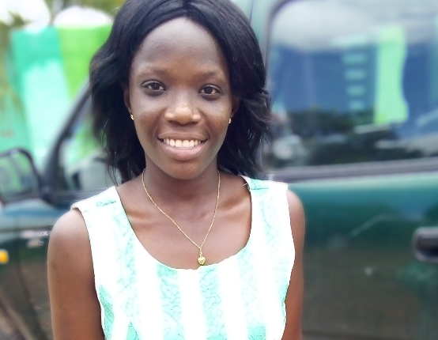
AKOSUA CURFUL
That’s her >>>>>>>>>>

